Slide 1
Chapter 10: Service as the Core Offering
Copyright © McGraw-Hill Education. All rights reserved. No reproduction or distribution without the prior written consent of McGraw-Hill Education.
McGraw-Hill Education
Part 3: Develop the Value Offering—The Product Experience

Slide 2
Learning Objectives
Understand why service is a key source of potential differentiation.
Explain the characteristics that set services apart from physical goods.
Explain the service-profit chain and how it guides marketing management decisions about service.
Describe the continuum from pure goods to pure services.
Discuss concepts of service quality and gap analysis.
Measure service quality through use of SERVQUAL.
Understand service blueprinting and how it aids marketing managers.

Slide 3
Why Service Is Important
A service is a product in the sense that it represents a bundle of benefits that can satisfy customer wants and needs, yet it does so without physical form.
We live in a service economy with more than 80% of U.S. jobs are service-related.
All domestic job growth is expected to be in the service sector.
Services produce 75% of GDP.
Notes:
Jobs represented in the service sector of the economy include such important categories as intellectual property, consulting, hospitality, travel, law, health care, education, technology, telecommunications, and entertainment—all high-growth job categories.

Slide 4
Service as a Differentiator
Focusing on service and on enabling employees to effectively deliver service can be one differentiator that is hard for the competition to replicate.
Great service provides sustainable competitive advantage.
Notes:
In his book On Great Service, Leonard Berry, a leading expert in the field of services marketing, advocates that a focus on service and on enabling employees to effectively deliver service can be one differentiator that is hard for the competition to replicate. Many firms are reluctant to invest in great service, largely because it takes time and patience before a return on the investment may be noticeable. But Berry’s point is that although the payback might take time, once a firm is able to deliver great service as a core differentiator, it is much more likely to provide a sustainable competitive advantage than are most other sources of differentiation.

Slide 5
A New Dominant Logic of Marketing
Service and the customer experience are at the core of marketing.
Service is the fundamental basis of exchange.
Goods or products historically were the basis of exchange but now unique skills and competencies (service) are.
Value is co-created by multiple parties, including the company and the customer.
Customers interact with the offering in different ways.
Value is defined by the customer.
Customers receive value from the experience, not the firm.
Notes:
Service is the fundamental basis of exchange. Remember that historically, goods or products were the basis of exchange. In the new logic, service (defined as unique skills and competencies offered by the company) is the basis of exchange. Put simply, customers don’t buy a car (product)—they buy the company’s ability to add value through a defined set of benefits. For example, a customer who may be concerned about safety will evaluate the company in terms of how well it builds safety into its cars. The more a company knows about safety and is able to build it into the customer’s car experience, the more favorable that customer will evaluate the company.
Value is co-created by multiple parties, including the company and the customer. The customer in an integral, even essential, part of creating value in the experience. To continue the car example, every customer interacts with the car in a different way, creating a unique value experience for that individual. His or her interaction can be initiated by the company’s marketing efforts (for example, the website could highlight key features), influenced by the salesperson pointing out certain functional or aesthetic elements of the car, and directed by the cars layout and physical characteristics. In the end, however, the customer creates a unique experience by interacting with the company’s marketing efforts and product in his or her own way.
3. Value is defined by the customer. Customers receive value from their experience, not from the company. The “bundle” of benefits that create value are different for each customer, making it important to understand the unique buying trends of specific customers in addition to broad customer behavior trends. So, while target markets may define the BMW product experience based on the driving experience or new technologies, individual customers can and do have very different definitions of the value delivered by BMW. It is clear that service dominant logic puts even more emphasis on data analytics and the ability to learn about individual customers in addition to broad markets. Since the customer is now central to value creation a “customer centric” approach that aligns people, processes, systems, and other resources to best serve customers is fundamental to a successful marketing strategy.

Slide 6
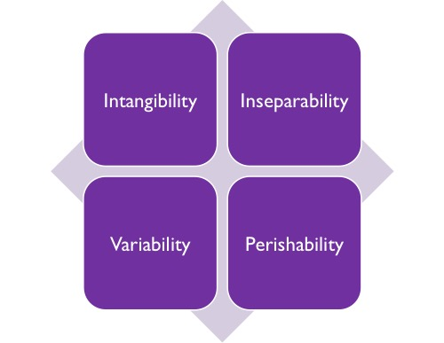
Characteristics of Services
EXHIBIT 10.1

Slide 7
Intangibility
A service cannot be experienced through the physical senses.
It cannot be seen, heard, tasted, felt, or smelled by a customer.
Goods can easily be experienced through the senses.
Strong branding can make a service seem more tangible.
Customers drawn conclusions about the tangible aspects they can experience.
Notes:
When it comes to making purchase decisions about services, customers draw conclusions from what tangibles they can experience—things like the company’s people, website, marketing communications, office ambience, and pricing. In a service setting, the importance and impact of marketing are heightened considerably because in many cases there’s little else tangible for the customer to experience before purchase. Sampling is a way to enhance tangibility.

Slide 8
Inseparability
A customer still can’t really experience it until it is actually consumed.
First the service is sold then it is produced and consumed at the same time and cannot be separated from its provider.
Allows for customization of service.
Notes:
Perhaps it is more accurate to think of a service as being performed rather than produced. In a theatrical play or an orchestral concert, many individuals have a part in the performance. Similarly, the quality of a service encounter is determined in part by the interaction of the players. Most elegant restaurants structure their customer encounters as elaborate productions involving servers, the wine steward, the maître d’, the chef, and, of course, the table of diners.
The inseparability of performance and consumption of services heightens the role of the human service providers in the customer’s experience. It also leads to opportunities for considerable customization in delivering the service. Finicky customers in the hair stylist’s chair can coax just the right cut. Want two scoops of cinnamon ice cream instead of one on that apple tort? Just ask the server.

Slide 9
Variability
Because it cannot be separated from the provider, a service’s quality can only be as good as that of the provider him/herself.
Employees can be a source of differentiation.
Removing variability and provide a dependable level of service.
Requires investment in training and good management in a culture that values employees.
Notes:
Ritz-Carlton, Nordstrom, Disney, and Southwest Airlines have become iconic firms in their industries largely by focusing on their people—hiring, training, keeping, and promoting the very best people they can get. Legendary Southwest Chairman Herb Kelleher built a business in part around ensuring that his people were different from typical airline employees— more engaged, fun, and fiercely loyal to the company. The same can be said for the other firms above. Focusing on employees as a source of differentiation in marketing is usually a smart move, mainly because so many firms just can’t seem to pull it off very well. The point is to remove much of the variability of customers’ experiences with your service and instead provide a more dependable level of quality. Go into any Nordstrom and work with any of Nordstrom’s sales associates and you will very likely experience the same high level of satisfaction with the service. The same is true for Ritz-Carlton, and any of the great service organizations.
With services, continual investment in training, retraining, and good management of people is required if variability is to be consistently low. It is in this area where the disciplines of marketing, operations, leadership, and human resource management probably have their closest intersection. What makes Ritz-Carlton great? A quick answer is: its people. But what makes its people great? World-class operations, leadership, and HR practices. And the net effect for Ritz-Carlton is that its branding and market positioning are largely defined by its wonderful people and the way they handle each customer as a valued guest. For service firms, great marketing cannot take place without a strong overarching culture that values employees.

Slide 10
Perishability
A service cannot be stored or saved up for future use.
Perishability is a major potential problem for service providers.
Fluctuating demand is related to perishability of services.
Notes:
Perishability is a major potential problem for service providers, and explains why, under the circumstances above, many physicians have a policy of charging the patient for the missed appointment. Ever wonder why an airline won’t issue a refund or let you change your super-low-fare ticket after the door closes and the plane leaves without you? It’s because the value of that empty seat—its ability to generate incremental revenue for the airline—dropped to zero when the door closed and the plane backed away from the gate.
Reservation systems help companies react to fluctuating demand. Wonder why kids eat free at restaurants on Tuesday nights? It’s the way restaurants try to create demand on the slowest night of the week.

Slide 11
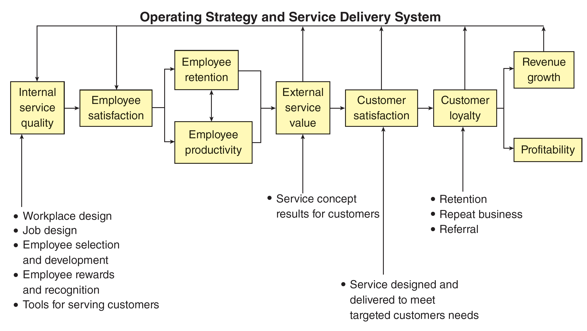
The Service-Profit Chain
EXHIBIT 10.2
Link to long alt text description
Reprinted by permission of Harvard Business Review, from “Putting the Service–Profit Chain to Work”, by James L. Heskett, Thomas O. Jones, Gary W. Loveman, W. Earl Sasser Jr. and Leonard A. Schlessinger, March/April 1994. Copyright © 1994 by the Harvard Business School Publishing Corporation; all rights reserved.

Slide 12
The Service-Profit Chain: Internal Service Quality
Internal Service Quality
Internal marketing, treating employees as customers, and developing systems and benefits that satisfy their needs, is an essential element of internal service quality.
Customer-centric firms place the customer at the center of everything both inside and outside the firm and have a high degree of customer orientation.
Firms focused on internal service quality hold a customer mindset.
Notes:
a focus on internal service quality implies that employees hold a customer mindset, meaning that employees believe that understanding and satisfying customers, whether internal or external to the firm, is central to doing their job well.

Slide 13
Internal Service Quality: Customer-Centric Firms
Firms practicing internal service quality are customer-centric:
They do the following:
Instill an organization-wide focus on understanding customers’ requirements.
Generate an understanding of the marketplace and disseminate that knowledge to everyone in the firm.
Align system capabilities internally so that the organization can respond effectively with innovative, competitively differentiated, satisfaction-generating goods and services.

Slide 14
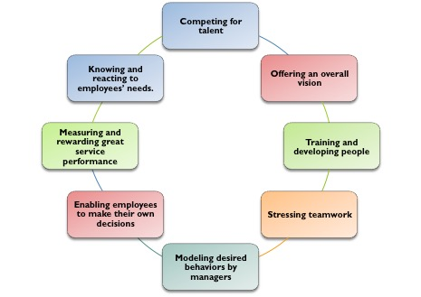
Satisfied, Productive, and Loyal Employees
Internal marketing must include the following:
Link to long alt text description
Notes:
Great service doesn’t happen without great people. A big part of making the service-profit chain work is creating an environment in which all employees can be successful.

Slide 15
Greater Service Value for External Customers
There is strong evidence that attention to internal service quality and to employee satisfaction, productivity, and retention result in stronger value to external customers of a service.
Customers set their expectations based largely on the evidence provided by the marketer before the purchase.
Customer expectations management: Do not set customer expectations so high that they cannot be effectively met on a consistent basis.

Slide 16
Customer Satisfaction and Loyalty
Loyalty sparks:
High customer retention: low propensity to switch, as well as repeat business and referrals.
Customer advocacy: a willingness and ability on the part of a customer to participate in communicating the brand message to others.

Slide 17
Causes of Switching Behavior
Pricing: high/increases/unfair/deceptive prices
Inconvenience: location/hours/wait time
Core Service Failure: service mistakes/billing errors/service catastrophe
Service Encounter Failures: uncaring/impolite/unresponsive/unknowledgeable
Response to Service Failure: negative or no or reluctant response

Slide 18
Causes of Switching Behavior
Competition: Found better service.
Ethical Problems: Cheating, hard selling, safety concerns, conflict of interest, and so on.
Involuntary Switching: Customer moved or provider closed.

Slide 19
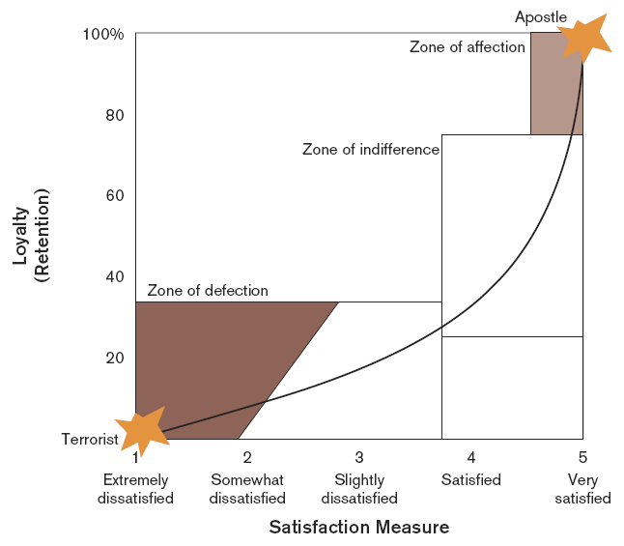
Focus on the Most Satisfied Customers
EXHIBIT 10.4
Link to long alt text description
Reprinted by permission of Harvard Business Review, from “Putting the Service–Profit Chain to Work”, by James L. Heskett, Thomas O. Jones, Gary W. Loveman, W. Earl Sasser Jr. and Leonard A. Schlessinger, March/April 1994. Copyright © 1994 by the Harvard Business School Publishing Corporation; all rights reserved.

Slide 20
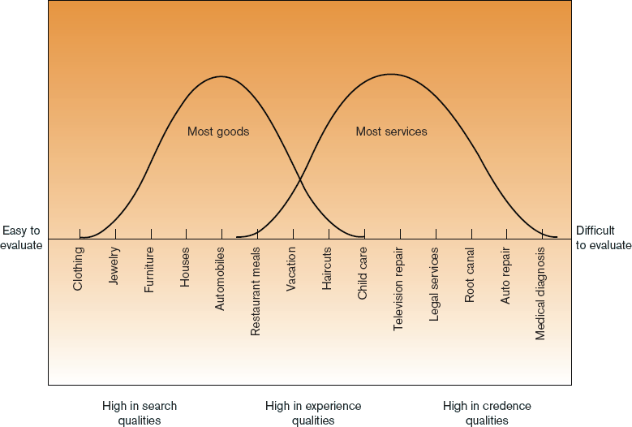
Continuum of Evaluation for Different Types of Offerings
EXHIBIT 10.5
Link to long alt text description
Source: Valarie A. Zeithaml, “How Consumer Evaluation Processes Differ between Goods and Services,” in Marketing of Services,
James H. Donnelly and William R. George, eds. 1991. Reprinted with permission of the American Marketing Association.

Slide 21
Service Attributes
Search attributes
Experience attributes
Credence attributes
Notes:
Depending on the type of offering, consumers may engage in a search for various alternative products to find the one that most closely meets their decision criteria for purchase. With physical goods, such comparison is usually relatively simple as there are many search attributes, which are aspects of an offering that are physically observable before consumption. Experience attributes are aspects of an offering that can be evaluated only during or after consumption. In many cases, a customer cannot make a reasonable evaluation of the quality of a service even after use. Services such as television repair, legal services, dentistry, auto repair, and medical services require specialized training to deliver. The customer may only know the desired end state—a car that runs or a pretty new crown molar. To assess these credence attributes would require customers to have expertise not generally shared by the public. As such, many providers of services in this category rely on professional certifications or degrees to convey a level of trust to the purchaser. Thus, services at this end of the continuum are often referred to as professional services—providers such as doctors, lawyers, accountants, even plumbers. They typically have industry or trade groups that self-regulate the quality of their services and serve as a clearinghouse for information and referrals.
One interesting professional service for

Slide 22
Service Quality
Service quality represents a formalization of the measurement of customer expectations of a service compared to their perceptions of actual service performance.
Service encounter: the period of interaction whether in person, by phone, or electronically
Customer delight: exceeding expectations often leads to customer loyalty
Moment of truth: the face-to-face time between customer and provider when most customer judgements take place.
Notes:
The term moment of truth was coined by Jan Carlzon who was CEO of Scandinavian Airlines (SAS) who wrote an informative book titled Moments of Truth. It’s a quick and excellent read for business students.

Slide 23
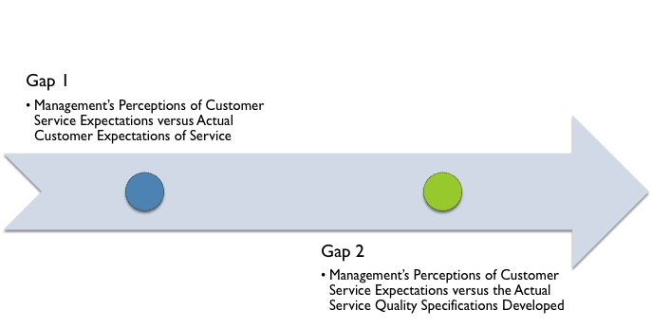
Gap Analysis: 1 and 2
Link to long alt text description
Notes:
Gap 1 is where a lack of the right customer data can wreak havoc on service delivery. Unfortunately, firms all too often make unfounded assumptions about customers’ wants and needs and translate them into product offerings. Then management is surprised when new products fail or customers begin to switch to other providers.
In Gap 2, management may or may not accurately perceive actual customer expectations of service, but regardless builds an aspect of the service delivery system that does not meet customer wants and needs.

Slide 24
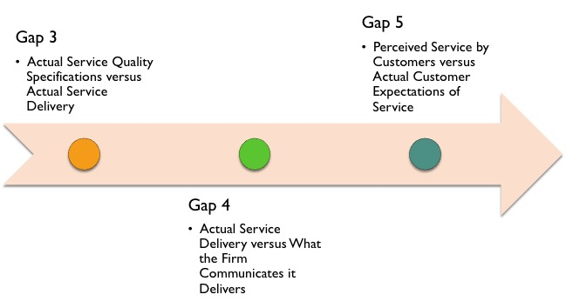
Gap Analysis: 3, 4, and 5
Link to long alt text description
Notes:
Interestingly, unlike the previous two gaps, this one has no element of perception—this gap strictly asks whether the service is provided in the manner intended. As such, when there is a negative gap at Gap 3, it nearly always points to management and employees simply not getting the job done. This could be due to vague performance standards, poor training, or ineffective monitoring by management.
Gap 4 fundamentally represents customer expectations management through marketing communications. through marketing communications.
Finally, Gap 5 represents the core issue of expectations versus perceptions and is the only gap that occurs exclusively in the customer’s space. This is the gap between the service a customer expects to receive and the customer’s perceptions of the level of service actually received. The score for this gap, which can be positive or negative, is the manifestation of a firm’s customer expectations management strategy and the efficacy of its service delivery system.

Slide 25
Service Recovery & Failure
Gap 3 addresses whether the service was delivered as intended.
Service Failure, when the service isn’t delivered as promised, provides an opportunity for service recovery. When properly handled, recovery doesn’t necessarily impact customer satisfaction, loyalty, or retention.

Slide 26
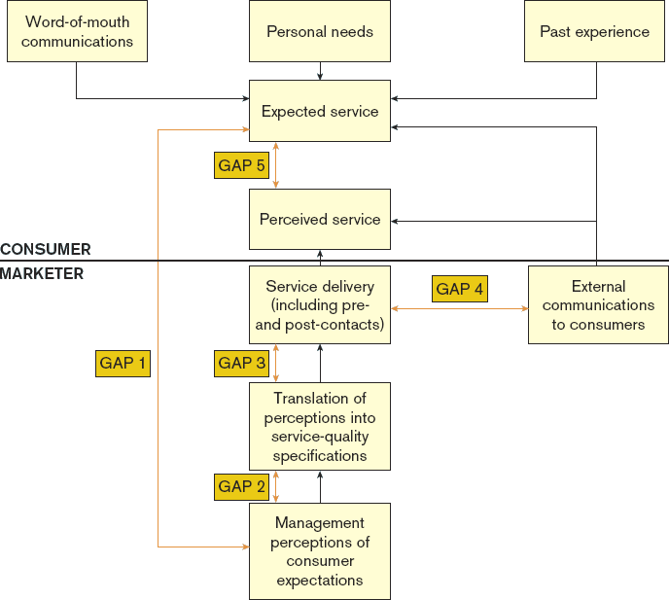
Gap Model of Service Quality
EXHIBIT 10.6
Link to long alt text description
Source: A. Parasuraman, Valarie A. Zeithaml, and Leonard L. Berry, “A Conceptual Model of Service Quality and its Implications for Future
Research,” Journal of Marketing, Fall 1985, pp. 41–50. Reprinted with permission of the American Marketing Association.

Slide 27
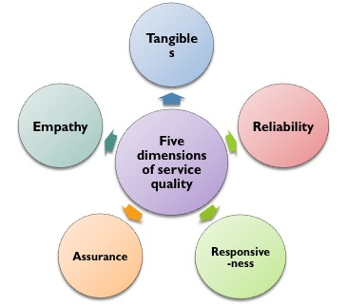
Service Quality
Dimensions of Service Quality
Notes:
Tangibles are the physical evidence of a service or the observable aspects that help customers form advance opinions about the service despite its general intangibility. Examples of tangibles include appearance of service providers, website, marketing communications materials, and the ambience and look of the office or retail store. Such tangibles send cues to the customer about the quality of the service.
Reliability is the ability to pro- vide service dependably and accurately and thus to deliver what was promised. Reliability means performing the service right the first time and every time. Research has consistently demonstrated that reliability tends to be one of the most important aspects of service quality.
Responsiveness is the willingness and ability to provide prompt service and to respond quickly to customer requests. Customers often complain about a lack of responsiveness on the part of service providers. Service providers exhibit poor responsiveness when they create difficulty making contact, exhibit poor follow-up, make excuses for poor service, and generally act as though they are doing the customer a favor.
Assurance is the knowledge and courtesy of employees, and the ability to convey trust and build a customer’s confidence in the quality of the service. Service providers often provide assurance primarily through their own competence in the job.
Empathy is the caring and individual attention a service provider gives to customers. Empathy means considering things from the customer’s point of view.

Slide 28
What Are Service Blueprints?
Service blueprints map out a complete pictorial design and flow chart of all the activities from the first customer contact to the actual delivery of the service.

Slide 29
Service Blueprints
A concept borrowed from manufacturing that maps out a pictorial design and flow chart from first point of customer contact through the last in each service delivery experience.
Lines of visibility divide what the customer sees and doesn’t see (e.g, have a front-stage and backstage).
Help identify bottlenecks.
Act as a training device for employees.
Give managers a tool for employee evaluations.
Notes:
A service blueprint is invaluable as a tool for marketing managers, especially for service encounters that are more complex than floral delivery, restaurants, and the like. First, the mere creation of the document serves to uncover potential bottlenecks in the service delivery system before it goes operational. Second, it represents a tremendous training device for employees involved in service delivery. Especially in a teamwork environment such as Outback Steakhouse where servers, cooks, and bartenders are so dependent on each other’s performance to maximize the customer’s positive experience overall, familiarizing each person involved in service delivery with exactly how his or her role fits into the entire system helps everyone take on a customer mind-set—even employees who ordinarily don’t directly interface with the external customers such as the cooks. Finally, using a service blueprint provides managers with an important way to integrate service topics into the performance evaluation process for all employees. Smart firms that rely on service for differentiation such as Outback, Ritz-Carlton, and Southwest Airlines provide incentives to their people who consistently con- tribute to the delivery of great service.

Slide 30
SERVQUAL
SERVQUAL is a survey instrument that reflects the dimensions of service quality.
Companies track results over time to measure improvement or decline.

Slide 31
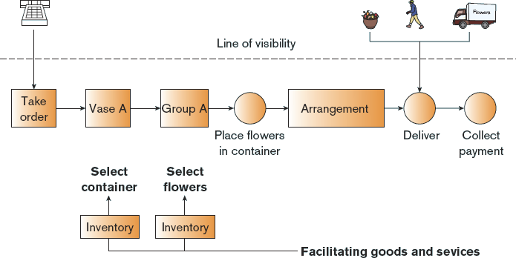
Service Blueprint for Floral Delivery
EXHIBIT 9.13
Link to long alt text description

Slide 32
Alt Text Appendix
All long alt text descriptions are included in this appendix.

Slide 33
The Service-Profit Chain
The operating strategy and service delivery system is complex. Internal elements include internal service quality and employee satisfaction. External factors include external service value, customer satisfaction, customer loyalty, and revenue growth. The components are displayed in a row to illustrate how they work together. Beginning at the far left, we see internal service quality. This is supported by workplace design, job design, employee selection and development, employee rewards and recognition, and tools for service customers. Internal service quality contributes directly to employee satisfaction, which influences both employee retention and employee productivity. These elements reinforce one another and also directly influence external service value. External service value is supported by service concept results for customers. External service value influences customer satisfaction, which is supported by whether service is designed and delivered to meet the needs of targeted customers. Customer satisfaction engenders customer loyalty, which is supported by retention, repeat business, and referrals. This loyalty leads to revenue growth and profitability.

Slide 34
Satisfied, Productive, and Loyal Employees
Internal marketing must include the following activities: competing for talent, offering an overall vision, training and developing people, stressing teamwork, modeling desired behaviors by managers, enabling employees to make their own decisions, measuring and rewarding great service performance, and knowing and reacting to employees' needs.

Slide 35
Focus on the Most Satisfied Customers
A chart displays the customer satisfaction level on the x-axis and customer loyalty, also called retention, on the y-axis. A graphed line curves up, showing that loyalty increases as satisfaction increases. The area around this line is divided into three zones. The zone of defection contains customers with a 35 percent level of loyalty and the lowest three levels of dissatisfaction. The lowest level of satisfaction is identified as level 1, extremely dissatisfied. These customers have zero loyalty and are called terrorists. Level 2 marks customers who are somewhat dissatisfied. The graphed line here shows customer loyalty is between 10 and 15 percent. In the zone of defection, the area containing satisfaction levels 1 and 2 below 35 percent is brown. This white area contains the third level of satisfaction, the slightly dissatisfied customers. At this point, the graphed line shows loyalty of between 15 and 20 percent. The zone of indifference contains customers who have satisfaction levels of 4 an 5, and loyalty levels of between 30 and 70 percent. The line's upward curve begins to steepen in this zone. Level 4 contains the satisfied customers. Here, the graphed line shows a loyalty level of between 30 and 60 percent. The next zone begins between levels 4 and 5. It is the zone of affection, which is also shaded brown. The zone of affection contains customers with satisfaction levels of 4 or 5 and loyalty levels of more than 70 percent. Level 5 contains the very satisfied customers. The graphed line shows these customers have loyalty levels of about more than 70 percent. Those customers with 100 percent loyalty and level-5 satisfaction are called apostles.

Slide 36
Continuum of Evaluation for Different Types of Offerings
Generally it is easier to evaluate goods than services. Two bell curves illustrate particular qualities of most goods and most services, with some overlap in the middle. The goods bell curve, at the left, contains the offerings that are easier to evaluate. The easiest to evaluate offerings are clothing, jewelry, furniture, houses, and automobiles. These are also the offerings that are high in search qualities. The services bell curve, on the right, contains the offerings that are more difficult to evaluate. The most difficult to evaluate are medical diagnosis, auto repair, root canal, legal services, and television repair. These are also the the categories that are high in credence qualities. There is an area of overlap between the goods and services bell curves. This contains offerings high in experience qualities. They are restaurant meals, vacation, haircuts, and child care. These fall under both the goods and services bell curves, right in the middle of the difficulty continuum.

Slide 37
Gap Analysis: 1 and 2
Two potential gaps are important to analyze. Gap 1 occurs first. This is the gap between management's perceptions of customer service expectations versus the actual customer expectations of service. Gap 2 occurs later. This gap is between management's perceptions of customer service expectations versus the actual service quality specifications that are developed.

Slide 38
Gap Analysis: 3, 4, and 5
Three potential gaps are related to actual service. Gap 3 occurs first. This is the gap between actual service quality specifications versus actual service delivery. Gap 4 occurs next. This is the gap between actual service delivery versus what the firm communicates it delivers. Gap 5 occurs last. It is the gap that is perceived by customers versus actual customer expectations of service.

Slide 39
Gap Model of Service Quality
A flow chart shows where each of the five gaps in service quality can occur. It also shows whether gaps occur on the consumer side (top) or the marketer side (bottom). Gap 1 is the only gap that spans the marketer and consumer sides. It occurs between management's perceptions of consumer expectations and the consumer's perceived service. Gap 2 occurs on the marketer side. It happens between management's perceptions of consumer expectations and translation of perceptions into service-quality specifications. Gap 3 occurs between the translation of perceptions into service-quality specifications and the service delivery, which includes pre- and post-contracts. Gap 4 occurs between the service delivery and external communications to consumers. Gap 5 is the only gap that occurs on the consumer side. It is the gap between perceived service and expected service. Other elements on the consumer side are word-of-mouth communications, personal needs, and past experience. External communications and service delivery are the two marketer activities that directly influence perceived service and expected service on the consumer side. Past experience, personal needs, and word-of-mouth are the consumer elements that directly influence expected service.

Slide 40
Service Blueprint for Floral Delivery
The flow chart begins with a picture of a telephone, which crosses the line of visibility as the florist takes an order. The following steps occur behind the line of visibility. The next step involves Vase A, which moves to Group A. The flowers are placed in a container before moving to the arrangement step. After that, the flowers are delivered. In the delivery step, the line of visibility is crossed again, so the flowers, delivery person, and delivery method can be seen by consumers. Finally, the collection of payment occurs behind the line of visibility. A smaller flow chart, also behind the line of visibility, illustrates facilitating goods and services. In this case, two inventory systems are used to select the container and the flowers.

